Slide 1
User needs to specifications

Slide 2
Why do we care about user needs and specifications?
Customer needs:
90% of all successful new products and services are grounded in real customer needs.
Independent of the product, customer needs point to opportunity spaces: gaps between ideal and actual.
Key question:
“what are the user’s unmet needs?”
Specifications:
Needs leave too much interpretation – it can be hard to know if your new service is satisfying the needs adequately if you do not identify the appropriate metrics.
Key question:
“what does the product need to do?”
Source: The Primacy of the Idea Itself as a Predictor of New Product Success. Jacob Goldenberg, Donald R. Lehmann, and David Mazursky; Management Science; 1998

Slide 3
There are four steps in the process of transforming customer needs into service specifications:
Make a thorough list of what the users said and did (from your empathy maps and user journeys)
Author need statements (based on your discussion of the empathy maps and user journeys)
Organize and prioritize the needs
Identify metrics for each need (how can you measure if the service is solving for the need?)
Identify your target specification (what value is ideal for each measurement?)

Slide 4

Our example will be focused on the service Uber X

Slide 5
Step 1: Make a thorough list of what the users said (interviews) and did (observations)
In your small group take turns sharing your empathy maps and user journeys. On the white board write down specific quotes and observations, highlighting areas where people were:
Frustrated
Wasting time
Wasting money
Unsafe
Identifying Polarizing issues
Example quote:
“I don’t like that all taxis won’t take my credit card”.
Example observation:
People trying to split fairs when paying for a taxi ride.

Slide 6
Step 2: Author need statements (based on list from interviews and observations)
Re-write each insight (the important quotes and observations you wrote on the board) in the voice of the user. We recommend writing each need statement on a separate sticky note. Be sure to make all the statements parallel: all the statements should share a similar sentence structure and equivalent detail. For example all statements should read “I need a <your service> that <what the service needs to do>”
Good examples (do this):
I need a car service that makes it easy to pay with a credit card.
I need a car service that speeds up my departure from the vehicle.
These examples state WHAT the service should do, not how. This will ensure there are multiple ways you can solve the problem, leading to more creative services. The statements are also written in a positive, not negative voice.
Bad examples (don’t do this):
I need a car service that uses an app to request a ride.
I need a car service that is not as disgusting and dirty as taxis.
These statements suggest how a product should solve for the need, this will limit the options you can consider and will likely lead to derivative, uncreative products.

Slide 7
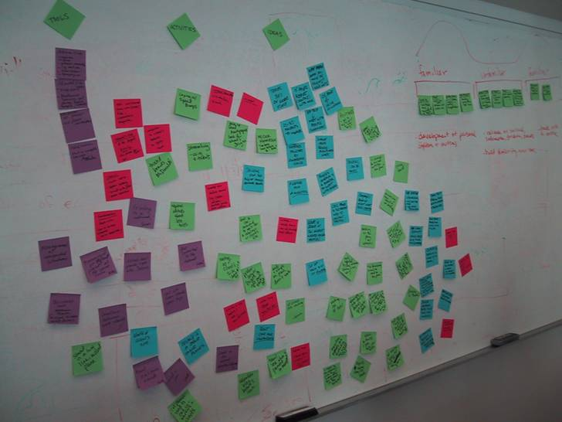
Step 2: Author need statements should look and feel like this:

Slide 8
Step 3: Organize and prioritize the needs
Review the list and eliminate any redundant needs.
Group similar needs, give the group of needs a descriptive name. (you should have between 5 – 7 needs per group)
Sort each group of needs into one of three categories:
The service MUST satisfy these needs: these are needs that have to be addressed or the service will not be viable (a car service needs to be safe and reliable)
Linear satisfaction needs: the more of these you can address the more the user will be satisfied with the service – distinguishing your service from existing alternatives. These are often needs that are well known to all but addressed in different ways / extents (a car service that is less expensive than taxis, a car service with shorter wait times for a ride).
Unknown needs: these are needs that are unarticulated by the user and potentially unknown to competitors. People are not expecting you to solve these needs, so when you do the service has a distinct advantage. Think of these as “bonus” needs (splitting a fair, paying for someone else’s ride).

Slide 9
Step 4: Identify metrics for each need (how can you measure if the service is solving for the need?)
For this step ask (for each need, not category), how can we measure if we satisfied the need? Remember, you are not defining the value of the metric at this point, just the metric. When doing this, keep in mind:
Look for common industry metrics (horsepower for cars, decibels for sound equipment).
Be practical, make sure that it is feasible and cost effective to take measurements.
Make sure the service has direct influence on the metric
Some things are not easily quantified, often the emotional / cultural aspects of the product. You still want to define a metric, but it may not be measurable in a truly scientific way. For example, you can determine that a new service should make someone feel accomplished because they use the service. It is hard to gain a scientific measurement of “accomplished”, but surveys and user interviews can help you establish a reasonable proxy.
Needs:
I need a more affordable car service
I need a car service that makes it easy to pay with a credit card
Metrics:
Total price of ride compared to equivalent taxi ride
Steps and time required to use a credit card when paying for a ride

Slide 10
Step 5: Identify your target specification (what value is ideal for each measurement?)
To adequately determine a target specification you need to do a combination of benchmarking (determining how existing offerings measure up) and user interviews (what do users expect, tolerate, what will delight them). For our class you will use the method most often employed in product development, a reasonable guess. It is important to have some rationale for each of your target specifications, even if it is initially a guess.
Needs:
I need a more affordable car service
I need a car service that makes it easy to pay with a credit card
Metrics:
Price compared to equivalent taxi ride
Time required to pay and exit the car
Target specification:
30% cheaper than an equivalent taxi ride
< 5 seconds to swipe / pay / confirm

Slide 11
Student example:

